Slide 1
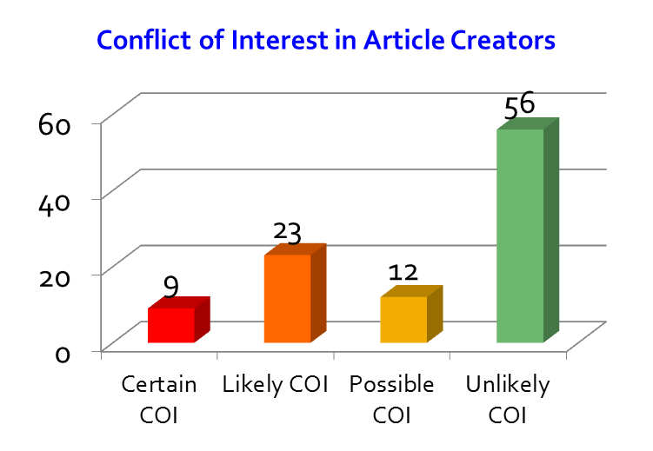
Creating articles about businesses
Study of 100 randomly-selected articles about businesses and organizations on Wikipedia:
About 4% to 12% of Wikipedia articles are about businesses, private non-profit organizations, or product brands (depending on what you may count as a “business”; e.g., airports, amusement parks, colleges, and orchestras were excluded from this study).
Article creator was defined as the editor most responsible for creating the article about the business.
Focus more than 50% of edits on one subject? Probably has a “conflict of interest”.
Among 100 business article creators, 37 devoted more than 50% of all their edits to the one article. In most of these cases, the concentration of edits exceeded 90%.

Slide 2
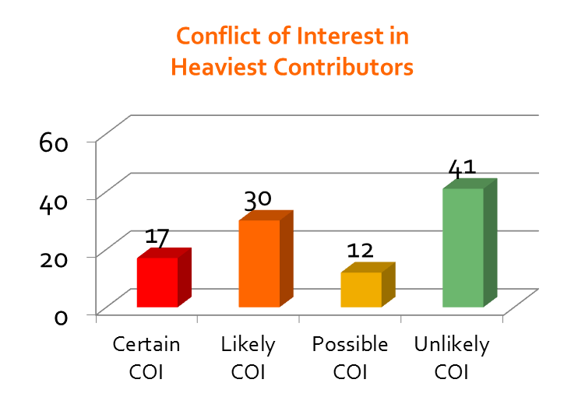
Building articles about businesses
Next, the study looked at the activity of each article’s heaviest contributor – defined as the editor who added the greatest total bytes of content that were not promptly removed within several days.
In 61 cases out of the sample 100, the corporate article's creator was also the heaviest contributor to the article, more than any single other subsequent editor.
In only 3 of the cases of the 100 heaviest contributors was the editor blocked by a Wikipedia administrator. Reason why?
User name matched the name of the business.
Among 100 heaviest contributors, 51 of them devoted more than 50% of all their edits to the one article about the business or organization. In most of these cases, the concentration of edits exceeded 90%.

