Slide 1
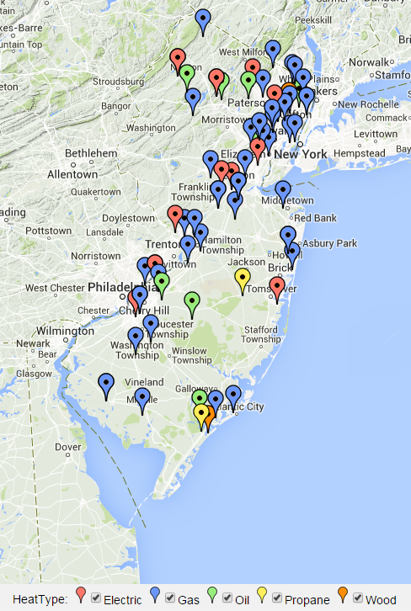


New Jersey home heating survey (n=74)
Don’t know:
Neutral Somewhat Very
Satisfied Satisfied

Slide 2
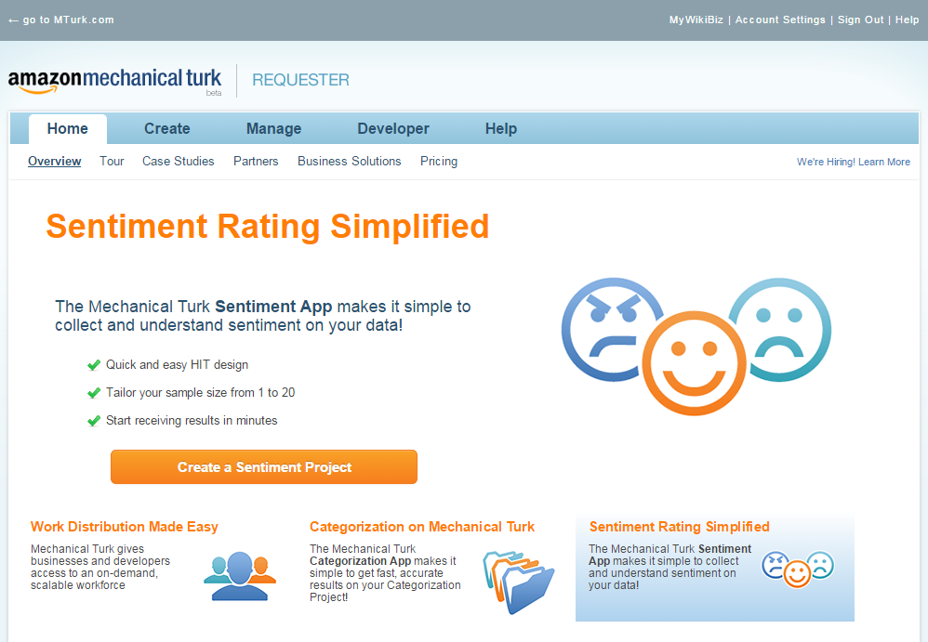
Mechanical Turk
What is it?
Named for Wolfgang von Kempelen’s chess-playing “Mechanical Turk” (1769)
Amazon.com – distributed labor network
Inexpensive survey platform
Test: Jan. 15 – Feb. 27 (2015)
New Jersey residents (n=74)

Slide 3
Mechanical Turk survey
Drawbacks
National Fuel Oil
Dowling
I Love Oil
Region Oil
7 Oil
Allen's Oil and Propane
Synergy
Senn Oil
No targeting below state level
Basic questionnaire tool
No follow-up contacts
Small sample sizes

Slide 4

Mechanical Turk survey
Benefits
Total cost of study
$8.14

