Slide 1
Use At Your Own Risk
Can Wikipedia be Trusted?
A presentation to Cheltenham High School
By Gregory Kohs
December 2011

Slide 2
What are Wikipedia’s flaws?
“Where to begin?”
“Fact-checking works poorly. People rarely check citations to see whether they support the ‘facts,’ and there is no process whereby experts are even invited to review articles, let alone post approved versions of them. Wikipedia factual quality is, as a result, very hit-or-miss.”
“Because Wikipedians (often admins) ‘sit’ on articles and act as de facto topic moderators, they often end up being biased and frequently quirky.”
“They have no trouble letting people with huge amounts of power in the system to operate anonymously. Not even highly-ranked admins have to reveal any information about themselves, or worry about repercussions to their reputation. Hence, a perfect playground for narcissistic abusers who hide behind anonymity.”
“Though it's supposed to be the ‘encyclopedia anyone can edit,’ admins and other well-connected Wikipedians are well-known for shutting down new contributors, especially if they do not ‘toe the party line,’ whatever it might be on the particular page.”
“Though they have tried to take some steps against this, the site is well-known for its tolerance of pedophiles.”
Commentary by Wikipedia co-founder,
Dr. Larry Sanger

Slide 3
When to use (and not to use) Wikipedia?
“I don’t know of anyone serious who questions that Wikipedia is an encyclopedia, and it is just absolutely false -- a smear -- to say that we don’t take ‘moral’ responsibility for the veracity of the content.”
“When we go down to younger students… certainly someone a lot younger than 16; a 10-year-old is writing a little short paper for class, and they want to say they got some information from Wikipedia, I think we should just be glad that the kid's writing and actually thinking about giving credit -- due credit -- to people who have helped. And I think that's wonderful.”
“For God sake, you’re in college; don’t cite the encyclopedia.”
“Our [Venezuelan president, Hugo] Chavez article has been a joke for a long time, dominated by a handful of people who have systematically excluded criticism of Chavez. …this article is very very bad and a huge disappointment…”
“Given enough time humans will screw up Wikipedia just as they have screwed up everything else.”
“Rachel Marsden first approached me via email two years ago with complaints about her bio. We had never met. I subsequently reviewed her bio and I found it not to be up to our standards. My involvement in cases like this is completely routine, and I am proud of it. I decided to meet Rachel Marsden in person for the first time in early February of this year. Accordingly, three days before that meeting, to avoid any appearance of a potential conflict of interest, I disclosed my plans to OTRS and further disclosed that it was a personal matter. I recused myself from any further official action with respect to her biography. …While I find it hard to imagine that anyone really cares about my sex life, the facts are: I am separated from my wife. I considered myself single at the time of my one meeting with Rachel Marsden on February 9th, 2008.”
Commentary by Wikipedia co-founder,
Jimmy Wales

Slide 4
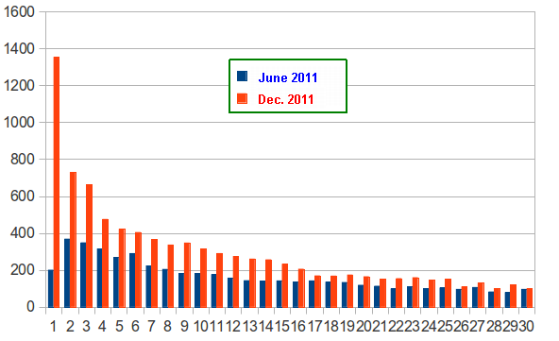
Wikipedia’s (increasing) stranglehold on Google
SearchRocket.com recently checked 13,827 different search terms on Google for Wikipedia’s ranking six months ago compared to today. In short, out of 13,827 searches, Wikipedia ranks in the top 100 results for 11,813 of the searches today compared to 7,777 of the searches six months ago.
The main difference appears to be in the first 30 search results (typically the first three pages of links returned by Google), so that portion of the graph is shown below:

Slide 5
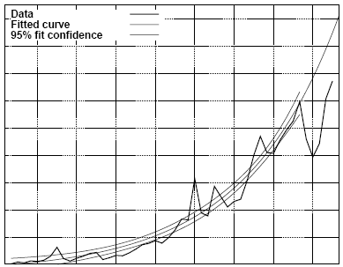
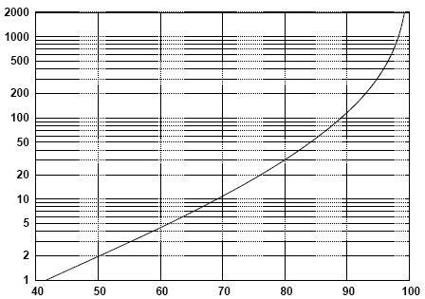
Wikipedia’s accuracy is not improving
“Creating, Destroying, and Restoring Value in Wikipedia”; Reid Priedhorsky, et al; University of Minnesota; Nov. 2007.
This study was the first to compute the impact of Wikipedia damage, using reader-based measures rather than author-based ones. The team analyzed 4.2 million editors and 58 million edits, over a nearly four-year period. About 5% of all edits to Wikipedia “damage” the content of Wikipedia.
Over time, the average reader of a typical Wikipedia article will have a greater and greater chance of encountering an error within the article.
About 10% of the damaging, false, or malicious edits to Wikipedia articles are not repaired even when over 100 people have viewed the page but have not corrected the damage. About 2% of such erroneous information is not repaired until after 2,000 people or more have viewed the misleading information.
Probability of
Wikipedia page
view being damaged
Time
Repaired within this
many page views
Percent of damaged edits

Slide 6
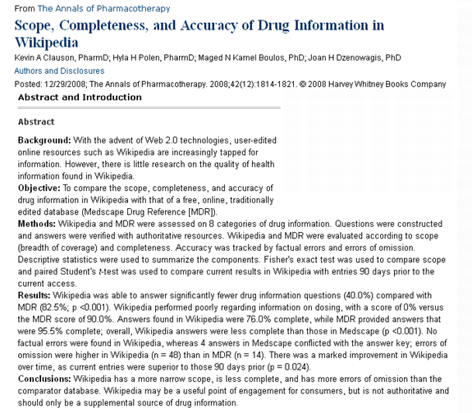
Wikipedia vs. Medscape Drug Reference
Questions answered:
Wikipedia: 40%
MDR: 83%
Completeness:
Wikipedia: 76%
MDR: 96%
Dosing information:
Wikipedia: 0%
MDR: 90%
Errors of omission:
Wikipedia: 48
MDR: 14

Slide 7
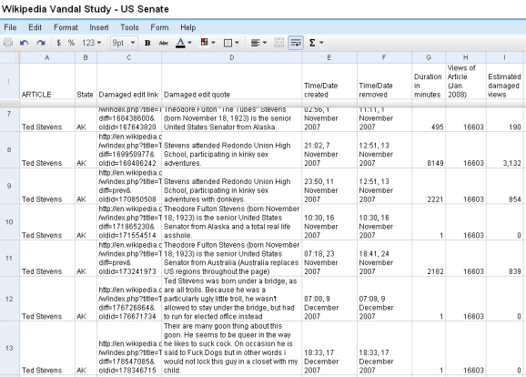
Wikipedia articles about U.S. Senators deliberately wrong nearly 7% of the time
“Wikipedia Vandalism Study: U.S. Senate”; Gregory Kohs, et al; MyWikiBiz; June 2008.
This study looked at one calendar quarter’s worth (4Q 2007) of edit data underlying the 100 Wikipedia articles about the (then) current United States Senators. What was found was discouraging. While most vandalized edits were brief in duration and clearly juvenile in content, a substantial portion of edits were plainly intended to be hurtful and defamatory against the Senators -- and they lasted for not just minutes, but hours, days, even weeks at a time.
Stevens attended Redondo Union High School, participating in kinky sex adventures.
4 days, over 3,100 views
Very few of the 100 Senators’ biographies were given the semi-protection padlock to prevent drive-by vandalism.
In all, the median duration of a damaged edit was 6 minutes, but the mean duration was 1,440 minutes (exactly 24 hours). These 100 articles were viewed approximately 12.8 million times in the fourth quarter of 2007. Over 378,000 of those views could be considered “damaged”, yielding a 3.0% rate of damaged views. There were about 13.2 million article-minutes during the quarter, and over 901,000 of those article-minutes were in a damaged state -- 6.8%.
For over 72 hours, the Wikipedia article about Senator John McCain said that he was "born in Florida in the then American-controlled Panama Canal Zone". The page was viewed nearly 93,800 times in this condition before it was corrected.
For more than 46 days, the Wikipedia article about Senator Maria Cantwell said that she "was voted most attractive United States Senator, among current and former members". The page was viewed over 7,800 times before it was corrected.
Jimmy Wales’ biography has enjoyed semi-protection on a continuous basis since 2007.
Stevens attended Redondo Union High School, participating in kinky sex adventures with donkeys.
2 more days, 850 more views

Slide 8
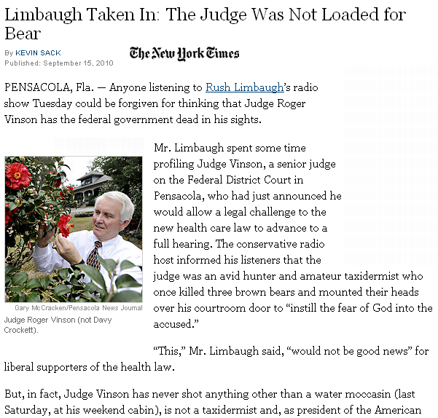
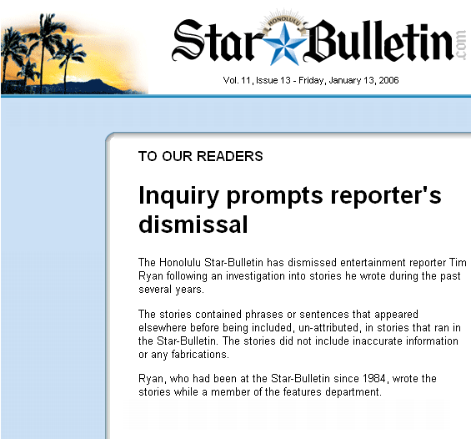
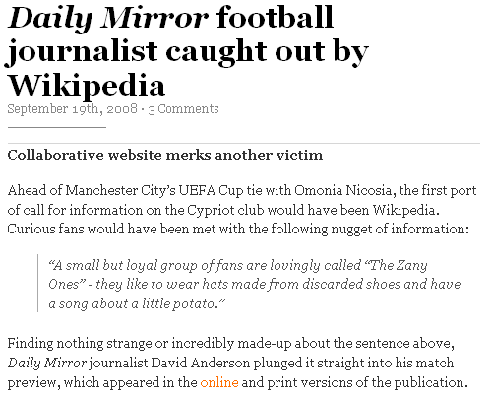
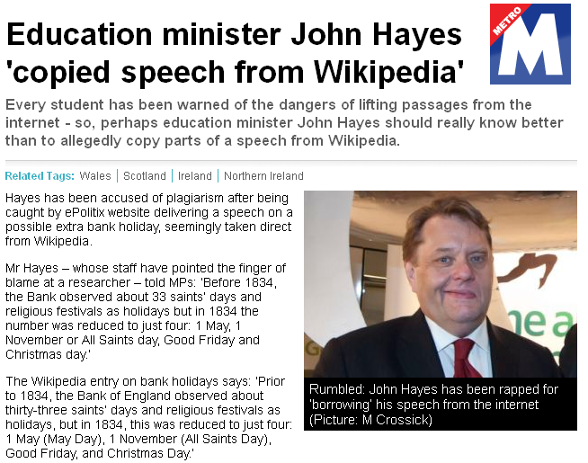
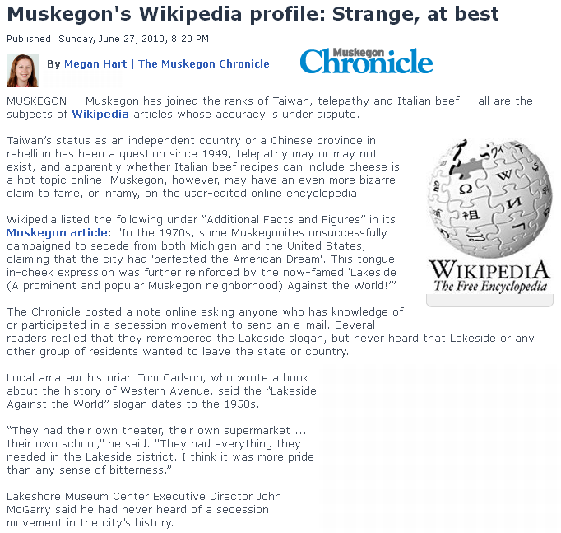
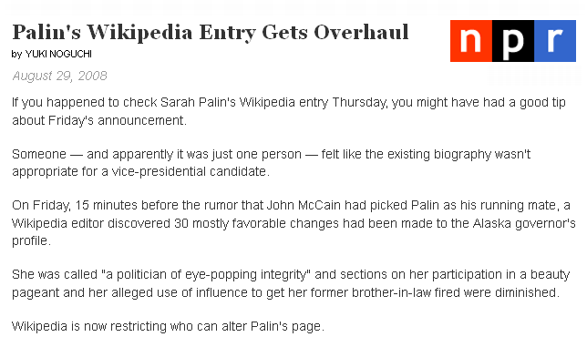
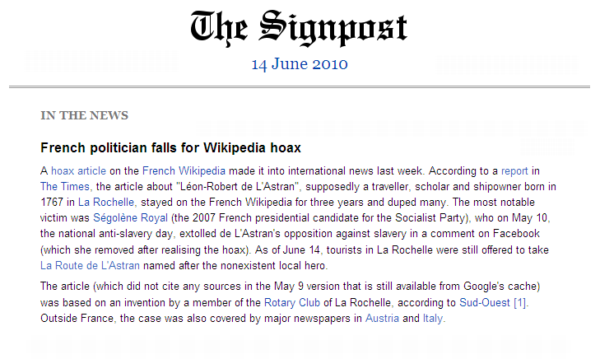
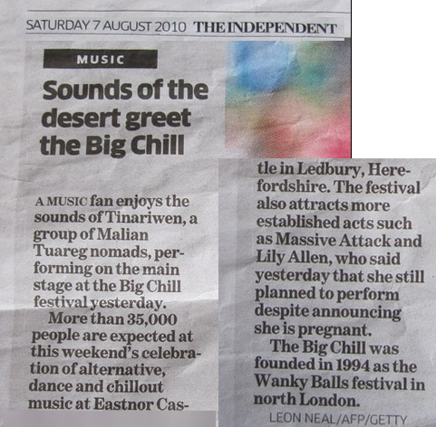
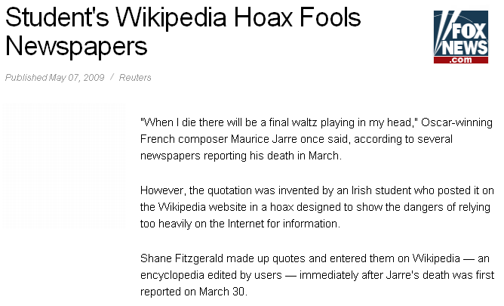
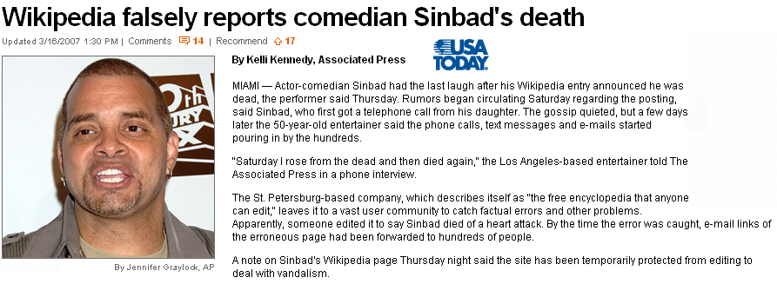
Who trusts Wikipedia? Who copies from it?

Slide 9

Who is Mike Ilitch, and where was he born?
Mike Ilitch is:
Owner of the Detroit Tigers
Owner of the Detroit Red Wings
Founder of Little Caesars Pizza
Ilitch was born in 1929, but where?
Macedonia¹
Detroit²
Macedonia³
Kingdom of Yugoslavia⁴
Macedonia⁵
Kingdom of Yugoslavia⁶
Kingdom of Serbs, Croats and Slovenes⁷
Detroit⁸
Kingdom of Yugoslavia⁹
Detroit¹⁰
Yugoslavia¹¹
Detroit¹²
I decided to speak with Karen Cullen, the Vice President of Corporate Communications at Ilitch Holdings, Inc. After confirming with others in her office, she stated that while Ilitch's parents were indeed Macedonian, Mike was in fact born in the city of Detroit, Michigan.
2004 | 2005 | 2006 | 2007 | 2008 | 2009 | 2010 | 2011

Slide 10
Which encyclopedia article lede do you prefer?
A hard disk drive (HDD; also hard drive or hard disk) is a non-volatile, random access digital magnetic data storage device. It features rotating rigid platters on a motor-driven spindle within a protective enclosure. Data is magnetically read from and written to the platter by read/write heads that float on a film of air above the platters.
A hard disk is a magnetic storage medium for a microcomputer. Hard disks are flat, circular plates made of aluminum or glass and coated with a magnetic material. Hard disks for personal computers can store up to several gigabytes (billions of bytes) of information.
A hard disk is part of a unit, often called a “disk drive,” “hard drive,” or “hard disk drive,” that stores and provides relatively quick access to large amounts of data on an electromagnetically charged surface or set of surfaces. Today's computers typically come with a hard disk that contains several billion bytes (gigabytes) of storage. A hard disk is really a set of stacked "disks," each of which, like phonograph records, has data recorded electromagnetically in concentric circles or "tracks" on the disk.
Wikipedia
Encyclopedia Britannica
WhatIs.com
IT encyclopedia

Slide 11
Which encyclopedia article lede do you prefer?
Human migration is the permanent change of residence by an individual or group; it excludes such movements as nomadism, migrant labor, commuting, and tourism, all of which are transitory in nature. Migrations fall into several broad categories. First, internal and international migration may be distinguished.
Migration (human) is the movement of people from one place in the world to another for the purpose of taking up permanent or semipermanent residence, usually across a political boundary. An example of “semipermanent residence” would be the seasonal movements of migrant farm laborers. People can either choose to move (“voluntary migration”) or be forced to move (“involuntary migration”).
Human migration is physical movement by humans from one area to another, sometimes over long distances or in large groups. Historically this movement was nomadic, often causing significant conflict with the indigenous population and their displacement or cultural assimilation. Only a few nomadic people have retained this form of lifestyle in modern times.
Encyclopedia Britannica
National Geographic
Wikipedia

Slide 12
Which encyclopedia article lede do you prefer?
A consumer economy refers to an economic system that primarily runs on consumers’ spending. In the U.S., it is often said and also often disputed that consumers are responsible for 70 percent of all spending and, therefore, this class of spender must be constantly stimulated to make money for businesses. There are other classes of spenders that represent a lower amount of spending and are usually ignored by attempts to revitalize the economy.
A consumer economy describes an economy driven by consumer spending as a percent of its gross domestic product, as opposed to the other major components of GDP (gross private domestic investment, government spending, and imports netted against exports). The often-quoted statistic for the United States, for instance, is that consumer spending amounts to 70% of GDP since 2001.
The consumer economy is that portion of the overall economic system that is dependent on individual or household consumer expenditures. Goods that embody the consumer economy would include food, clothing, housing, furniture, appliances, automobiles, etc.; while services that comprise the consumer economy would include restaurants, private hospital care, personal banking, commercial airlines, etc.
WiseGeek.com
Wikipedia
MyWikiBiz.com

Slide 13
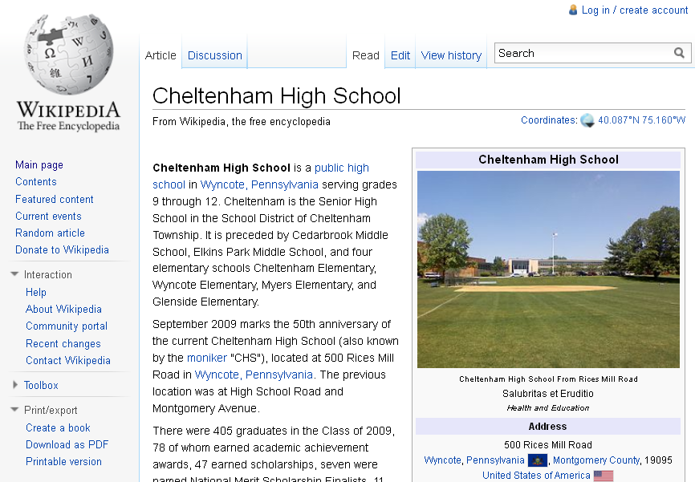
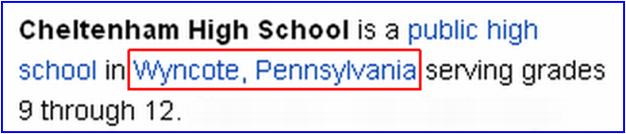
Where is Cheltenham High School?

Slide 14
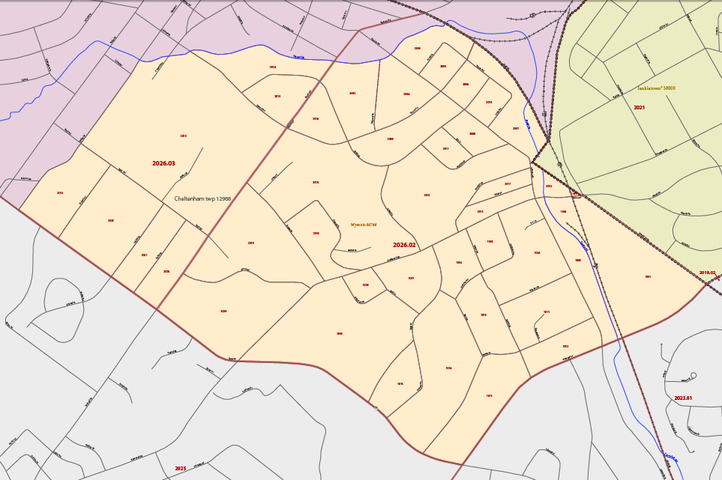
According to the U.S. Census Bureau
Wyncote, Pennsylvania
Cheltenham High School

Slide 15
According to local authorities
Nancy K. Gibson, Public Information Officer for Cheltenham Township, replied:
“…your question seems to be what municipality -- the lowest level of government with legal boundaries -- is Cheltenham High School located in, then the answer is Cheltenham Township.”
The Montgomery County Board of Assessments (Real Estate Division) confirms that the title deed for Cheltenham High School shows that it is in Cheltenham Township.
Nonetheless, Wikipedia has stated since August 2006 that Cheltenham High School is “in Wyncote, Pennsylvania”.

Slide 16
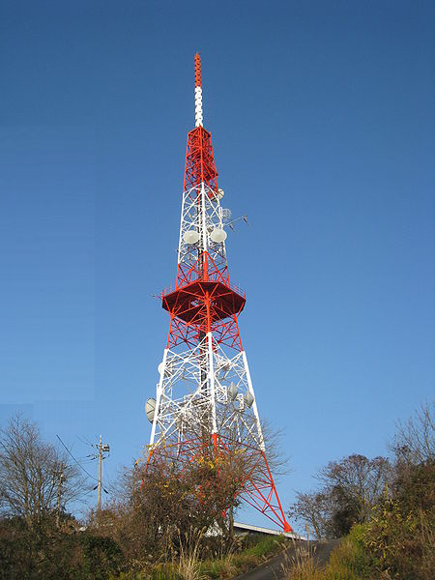
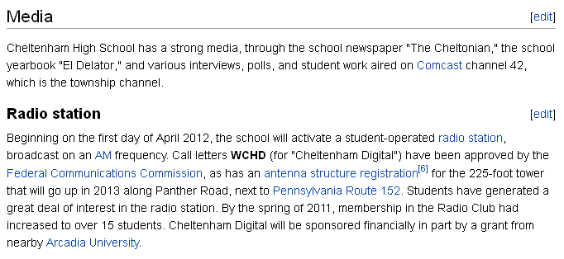
WCHD – Cheltenham Digital Radio
Wikipedia
Which reference source is cited? The Federal Communications Commission.
When does the station launch? April 1, 2012.
How many Wikipedia page views witnessed this entirely phony radio station? Over 2,200 on Wikipedia thus far (Oct. 26 to Dec. 14, 2011); not to mention, additional views elsewhere, thanks to the scraper effect.

Slide 17
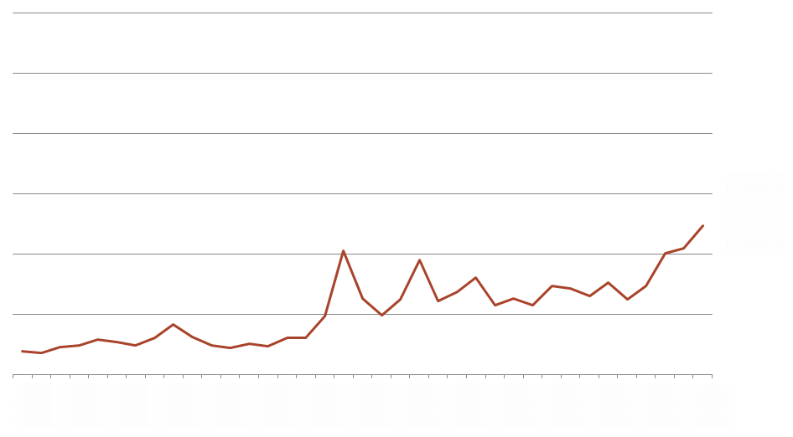
Page views: A company
Buyout offer
Offer rejected
Hired MyWikiBiz

Slide 18
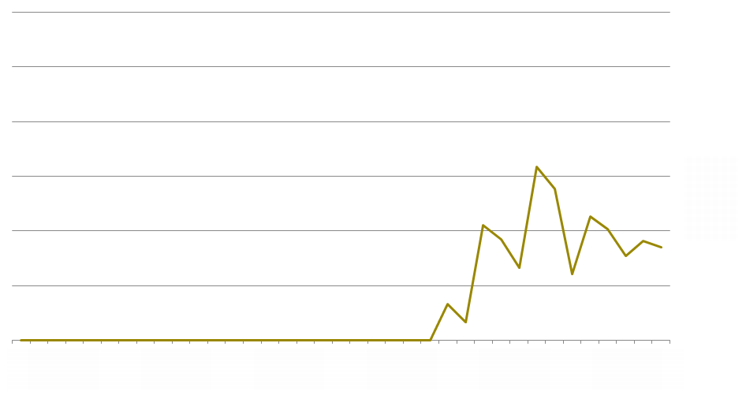
Page views: An artist
Book published
Hired MyWikiBiz
Article created by another paid editor

Slide 19
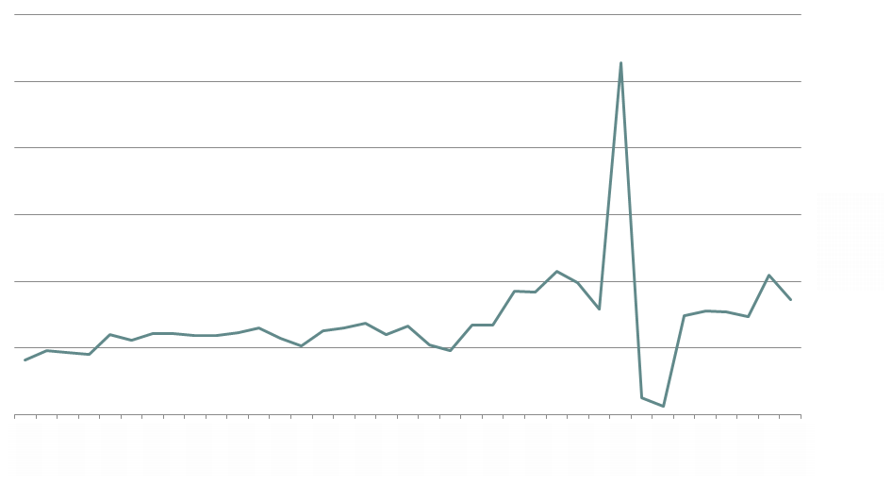
Page views: A musical group
Article nominated for deletion
Hired MyWikiBiz
Article deleted

Slide 20
After today, will you use Wikipedia in the same way as you did before today?
Additional sources that critique Wikipedia:
National Wiki Examiner, Gregory Kohs
Top 10 Reasons Not to Donate to the Wikimedia Foundation, Gregory Kohs
WikipediaReview.com
WikiTruth.info
The Cult of the Amateur, Andrew Keen
Continue to see survey results!
Thank you for listening.

Slide 21
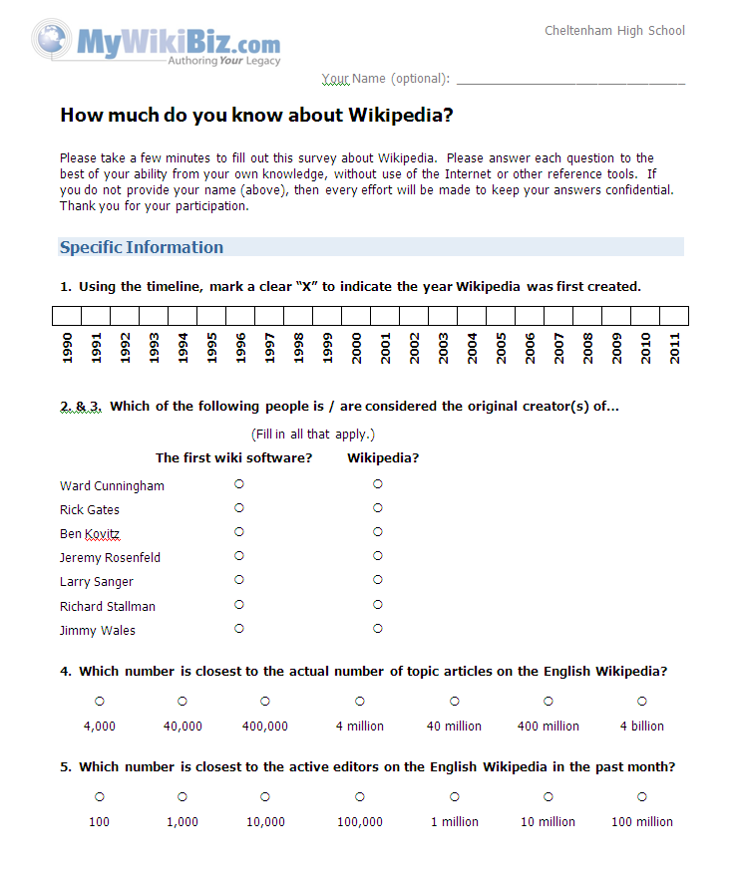
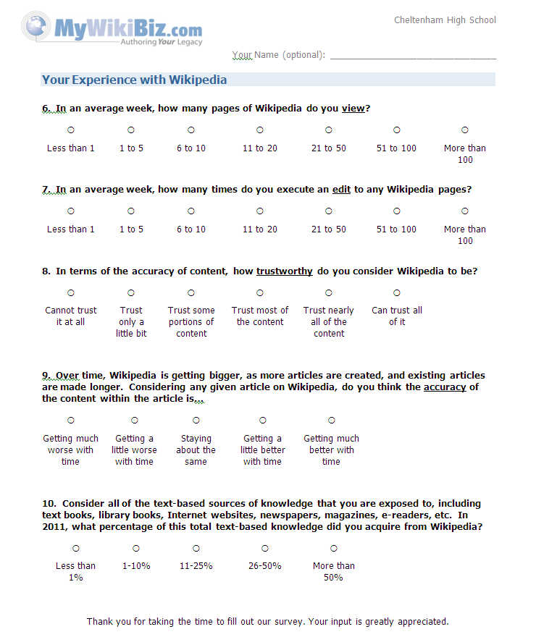
Epilogue: Survey administered to audience

Slide 22
Epilogue: Survey results
Prior to delivering this presentation, Mr. Kohs administered a brief, two-page quiz about Wikipedia and about personal behaviors related to Wikipedia. There were 17 students and 3 teachers in the respondent sample (n=20).
Only 10% correctly knew 2001.

Slide 23
Epilogue: Survey results
Which of the following people is / are considered the original creator(s) of…
Only 20% correctly knew Cunningham.
While 45% correctly identify Wales, only 10% correctly name Sanger.

Slide 24
Epilogue: Survey results
Only 25% correctly knew 4 million.

Slide 25
Epilogue: Survey results
Only 15% correctly knew 100,000.

Slide 26
Epilogue: Survey results
Note, however, for students at the high school, Wikipedia is blocked on web browsers.
Teachers have access to Wikipedia.
Respondents
None of the respondents viewed Wikipedia more than 20 times per week. Little to no Wikipedia editing activity is performed by any of the sample.

Slide 27
Epilogue: Survey results

Slide 28
Epilogue: Survey results

Slide 29
Epilogue: Survey results

Slide 30
Contacting the author of this presentation:
Gregory Kohs
MyWikiBiz.com
489 Lake George Circle
West Chester, PA 19382
ResearchBiz@gmail.com
Phone: 484-NEW-WIKI (484-639-9454)

